Slide 1




Sensitivity of North American Monsoon Convective Precipitation Flooding in Arizona to the Atmospheric Boundary Layer and Circulation
Brooke Sullivan
Mentor: Dr. Dorothea Ivanova

Slide 2
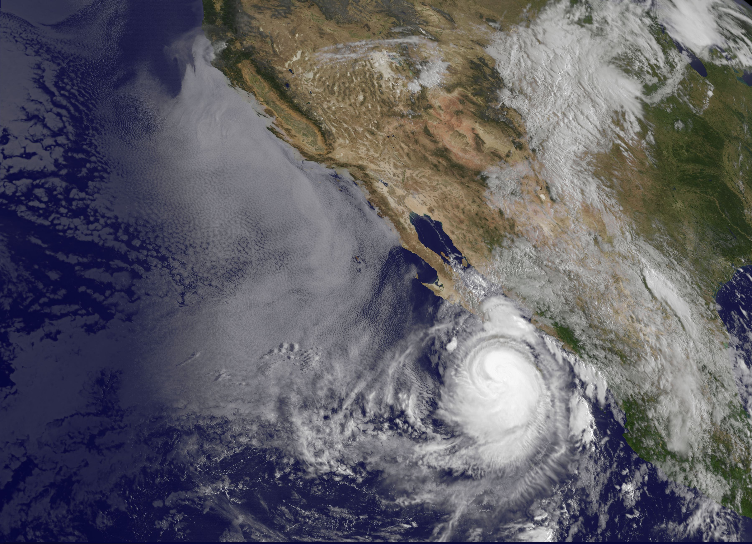
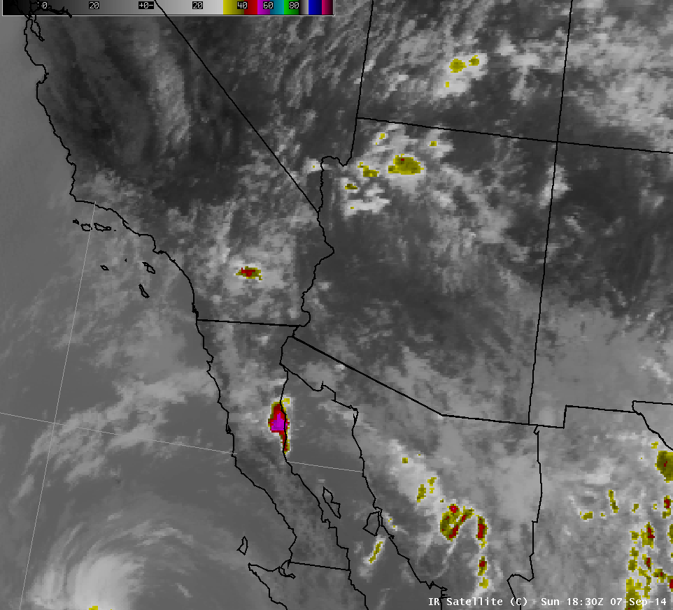
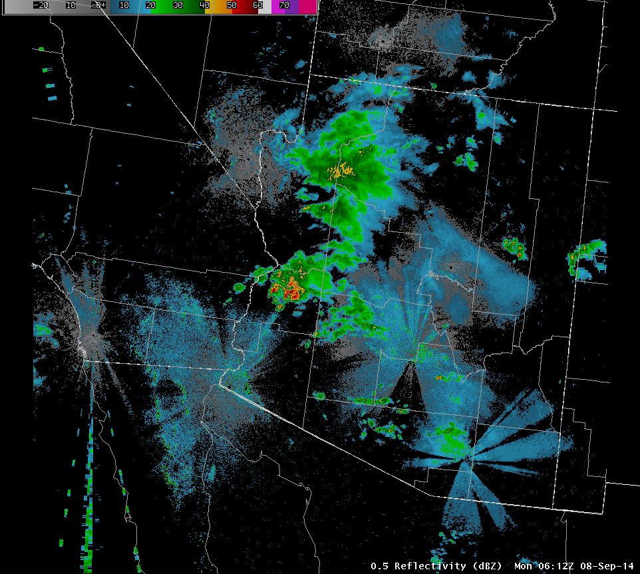
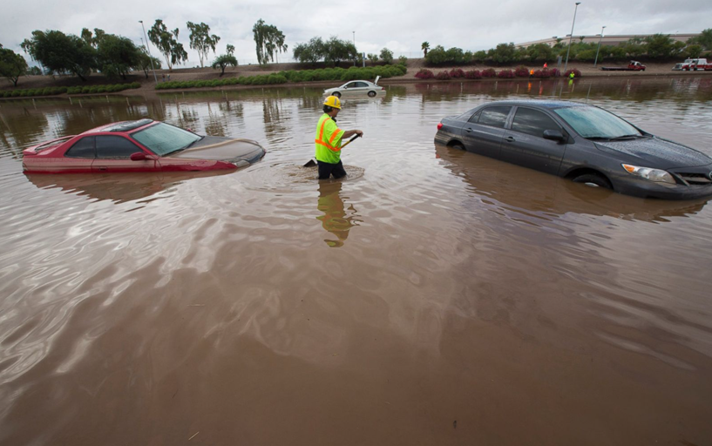

Significance of Event and Emergency Response
Hurricane Norbert strengthened on September 6th, 2014
Heavy rain event lasted from 10pm MST on the 7th until 11am MST on the 8th
Caused devastating flooding in Central AZ
$16.3 million in damages in Maricopa County, $1.1 million in La Paz County
Officials declared a statewide emergency and within the Phoenix metro
FEMA approved federal disaster assistance for Maricopa and La Paz counties

Slide 3
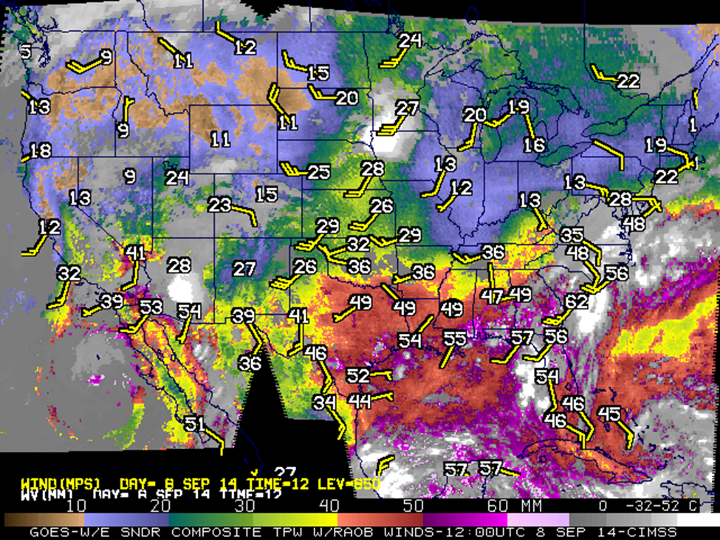
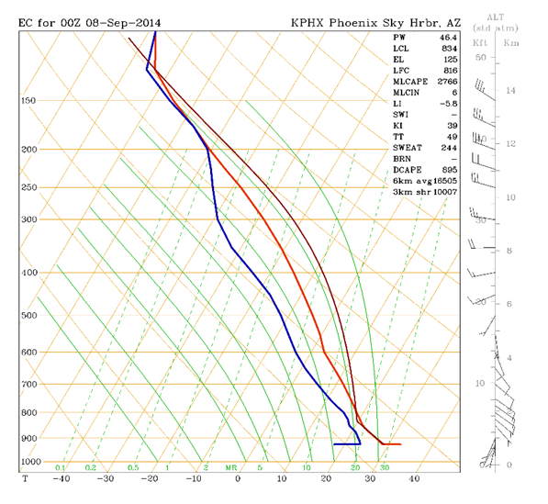
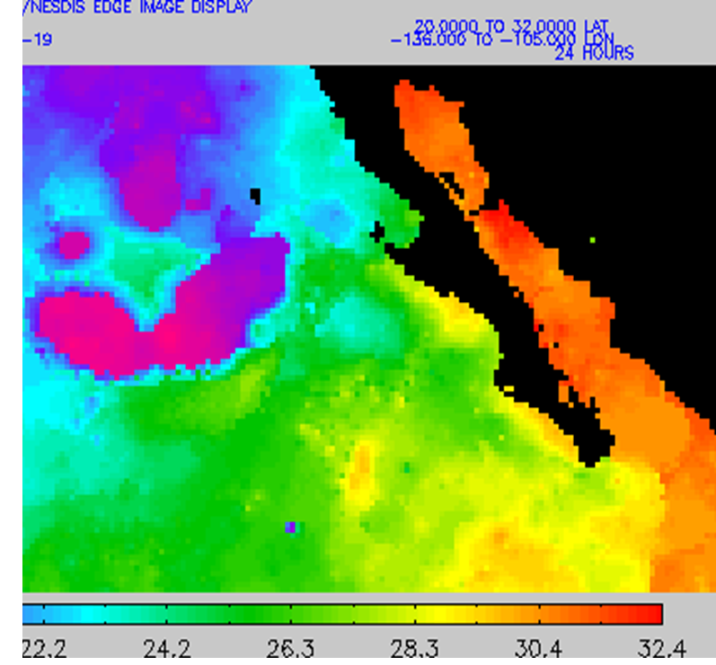
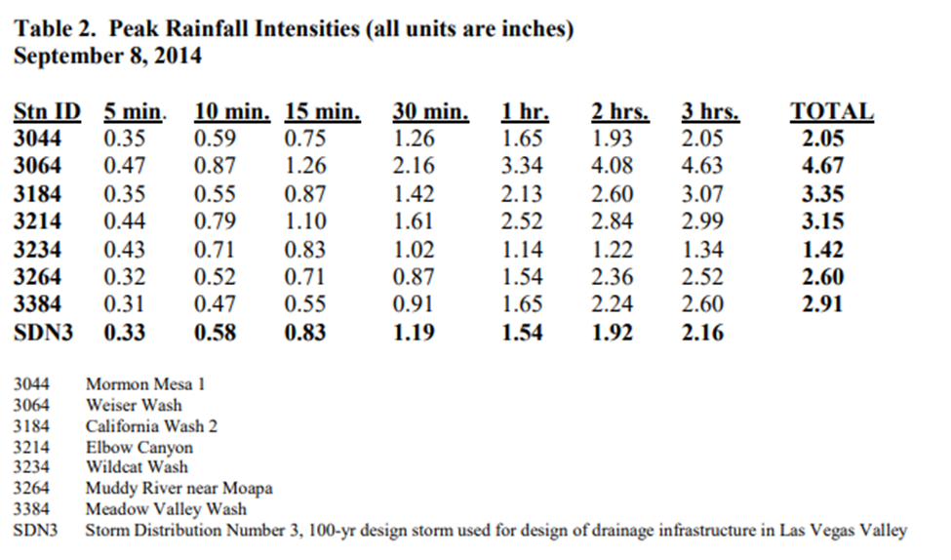
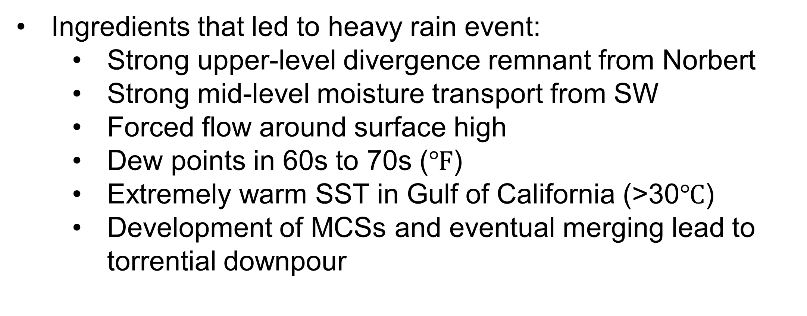
Convective Environment
Ingredients that led to heavy rain event:
  Strong upper-level divergence remnant from Norbert
  Strong mid-level moisture transport from SW
  Forced flow around surface high
  Dew points in 60s to 70s ($℉$)
  Extremely warm SST in Gulf of California (>30$℃$)
  Development of MCSs and eventual merging lead to torrential downpour

Slide 4
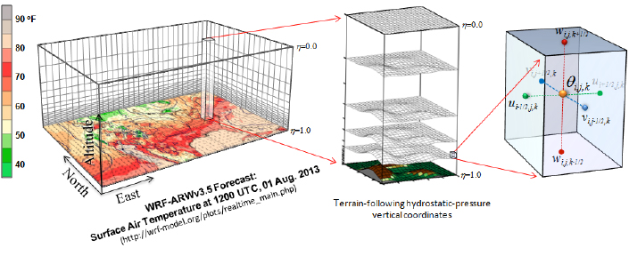
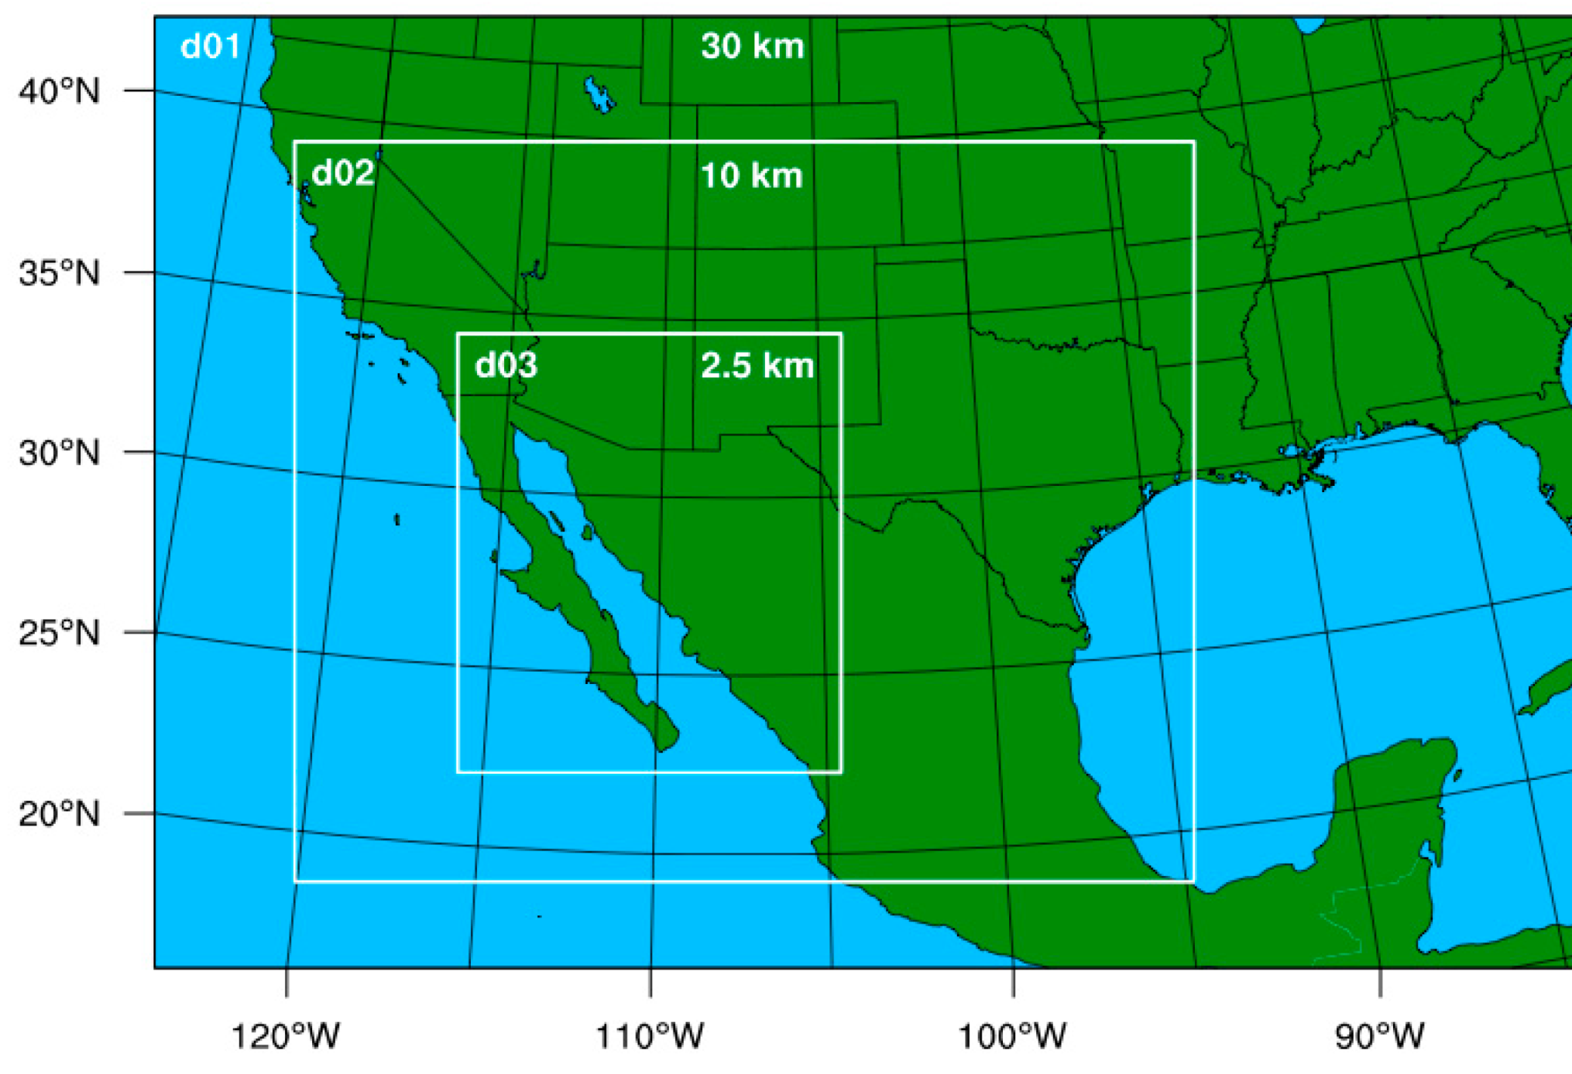
Research Objective – Using the WRF-ARW Model
Advanced Research Weather Research and Forecasting mesoscale model (ARW-WRF) – Version 4.4.1
Two-way nesting procedures were executed:
  Outer domain (30 km grid resolution)
  Second nest (10 km grid resolution)
  Third nest (3 km grid resolution)
A Rapid Update Cycle (RUC) land-surface model was used for topographical features
A convective parameterization was used specializing in entrainment and comprehensive microphysics

Slide 5
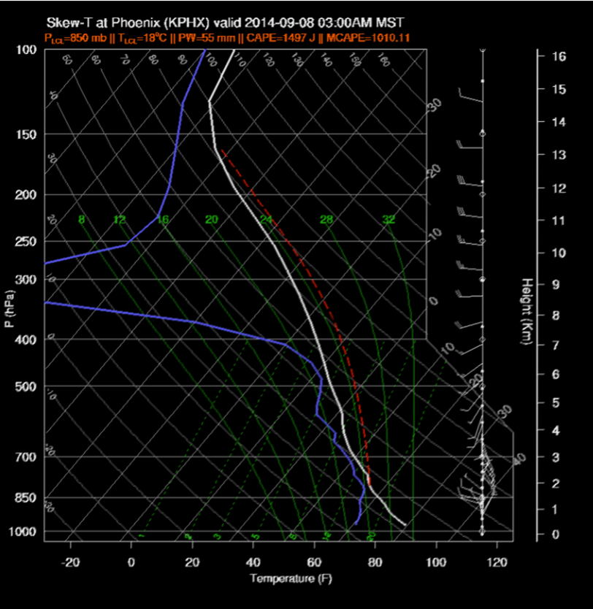
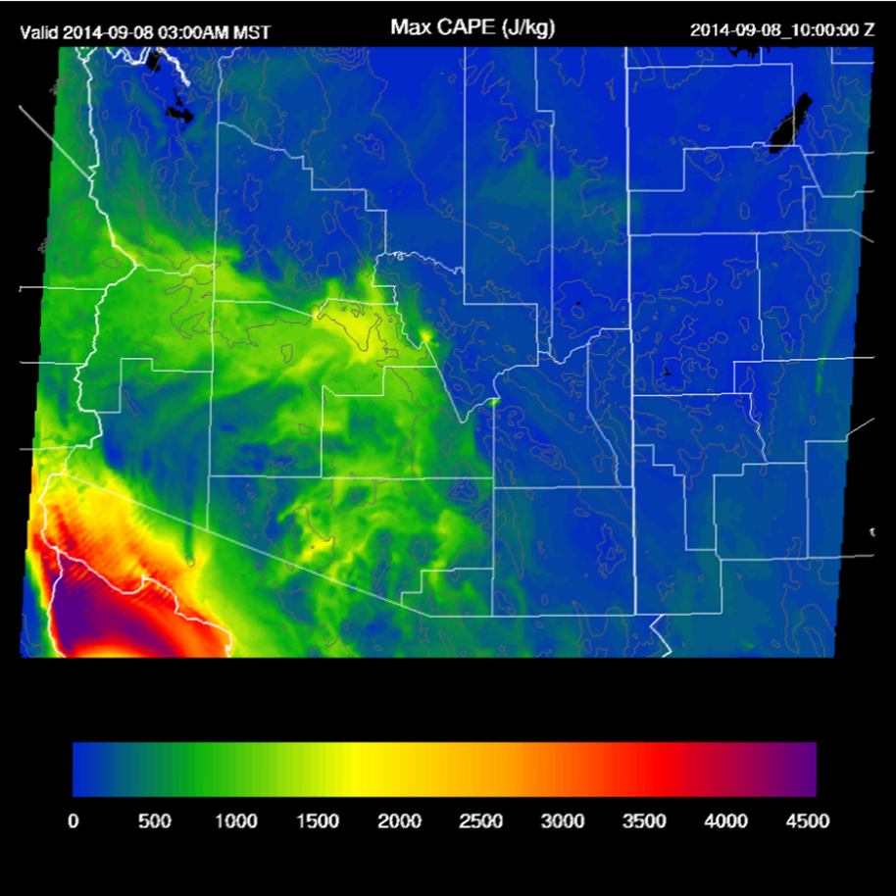
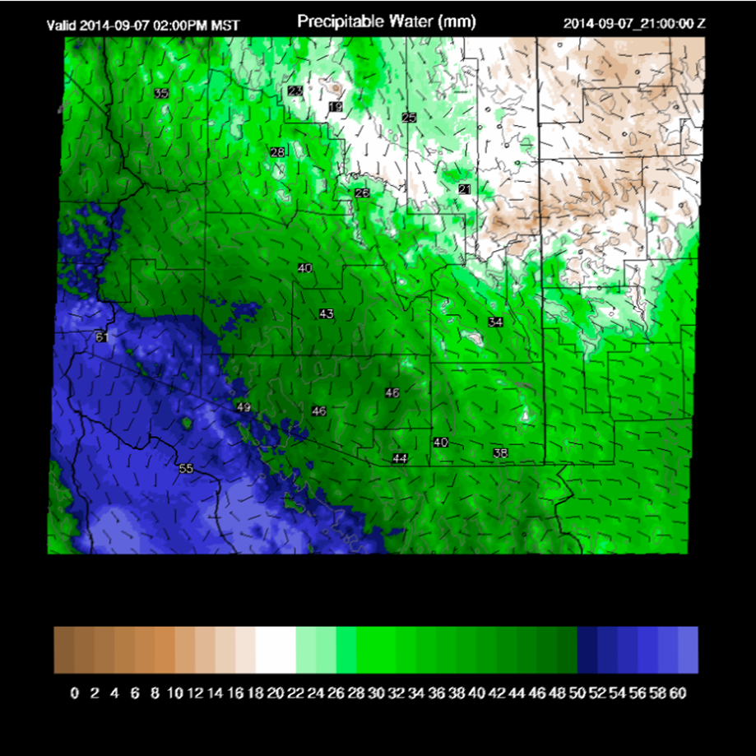
WRF-ARW Model Outputs
Fig. High CAPE, supports strong early morning storms in and around Phoenix. Note the strong mid-level winds
Fig. CAPE is increasing in Arizona during the early morning hours of September 8th, 2014
Fig. Winds and Precipitable Water (PW) September 7th, 2014. Heavy rain is a big threat for PW of 43-49 mm

Slide 6
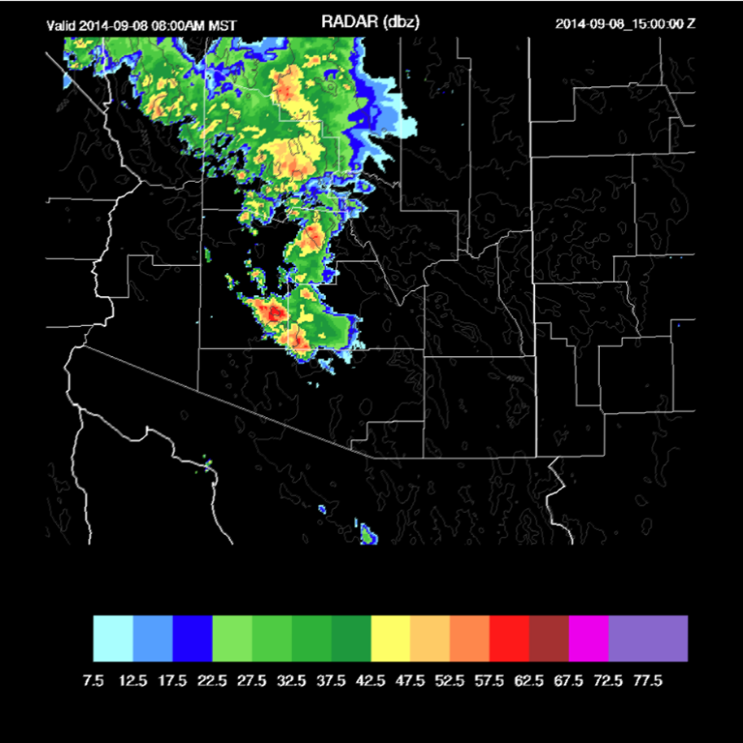
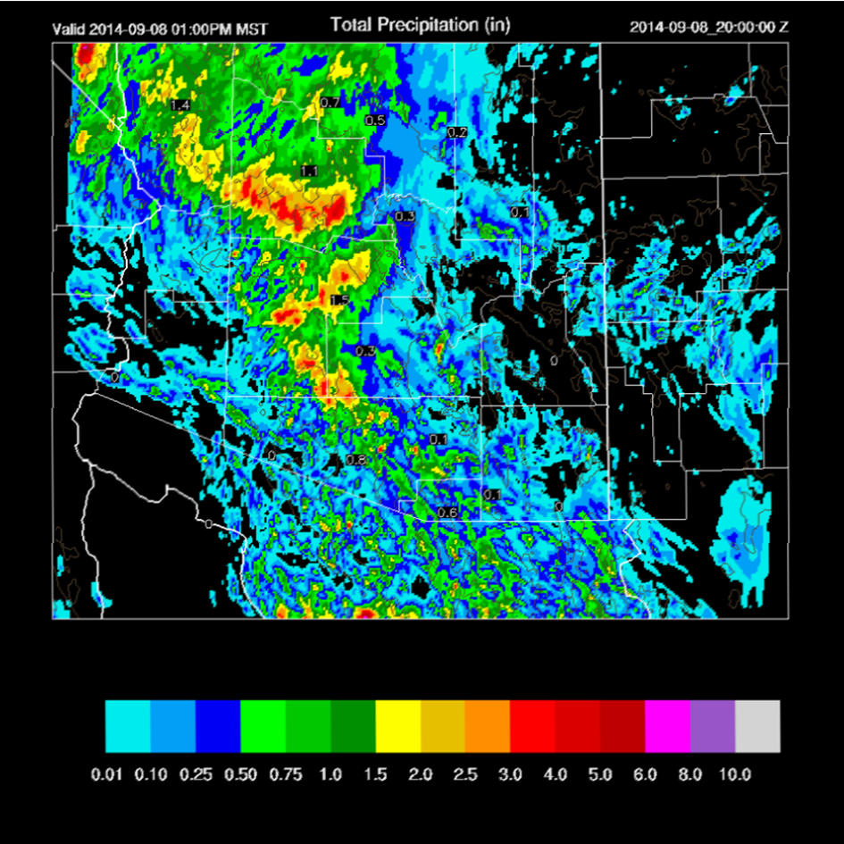
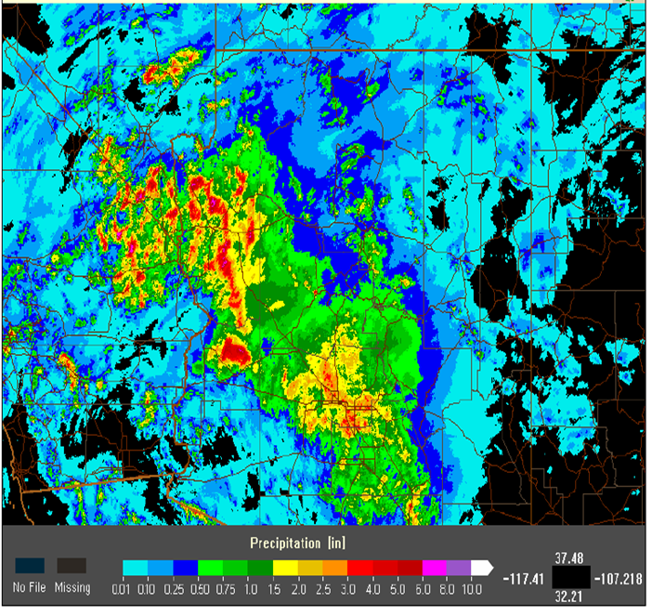
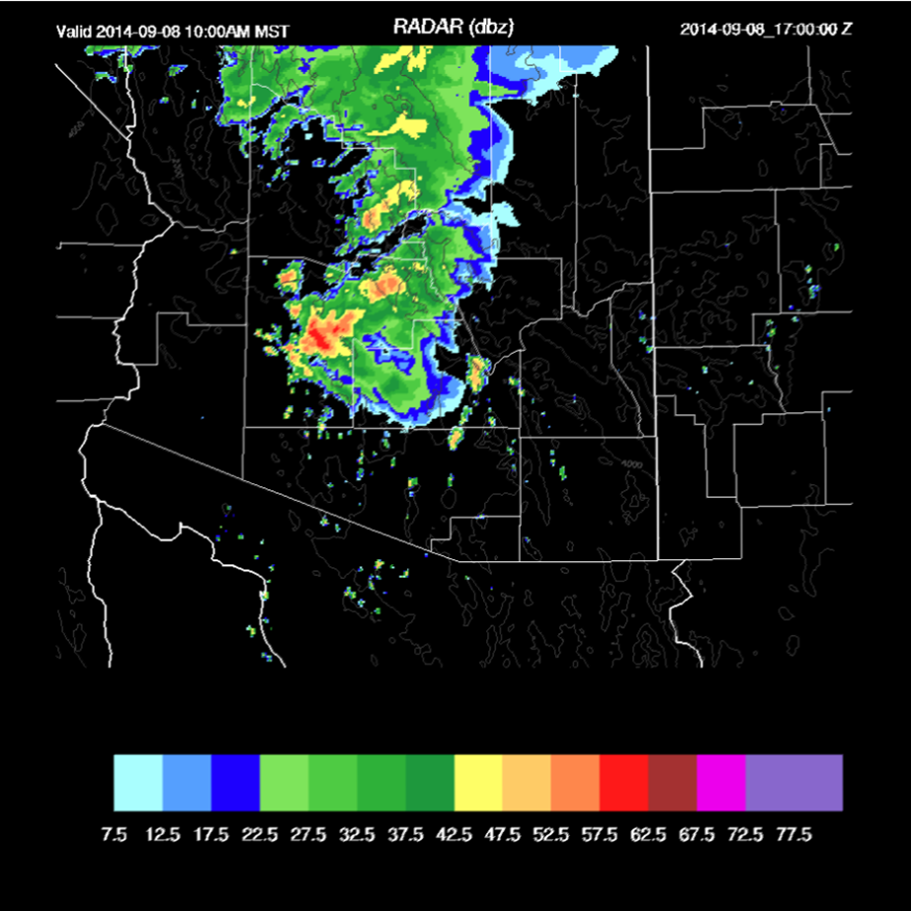
WRF-ARW Validations
WRF model predicted radar output for 1800Z 8th Sept., at the time of the flood
It also predicted rain would propagate over Tucson on 1200Z on 9th Sept. 2014
Fig. WRF Radar output, 8th Sept. 2014. Widespread deep convection underway at 15Z in the morning
Fig. Total Precipitation. NOAA Reanalysis. 8th Sept. 2014
Fig. WRF Radar output, 8th Sept. 2014. Major flash flood event for the Phoenix area
Fig. Total Precipitation. WRF. 8th Sept. 2014

Slide 7

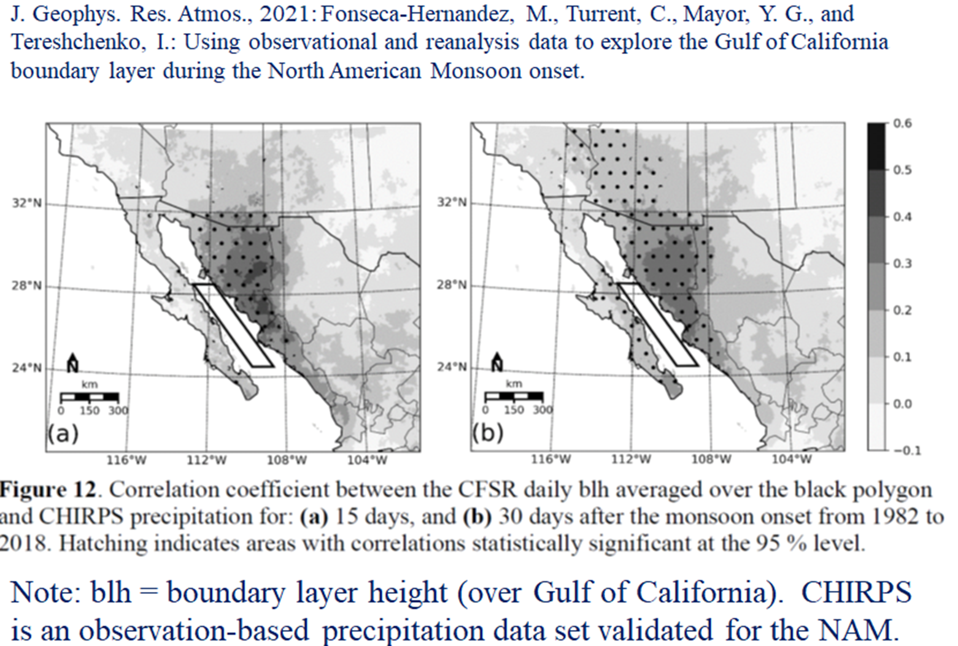
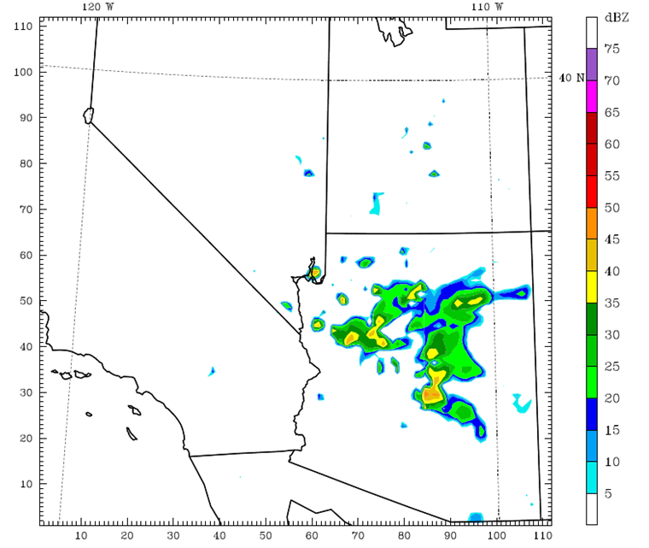
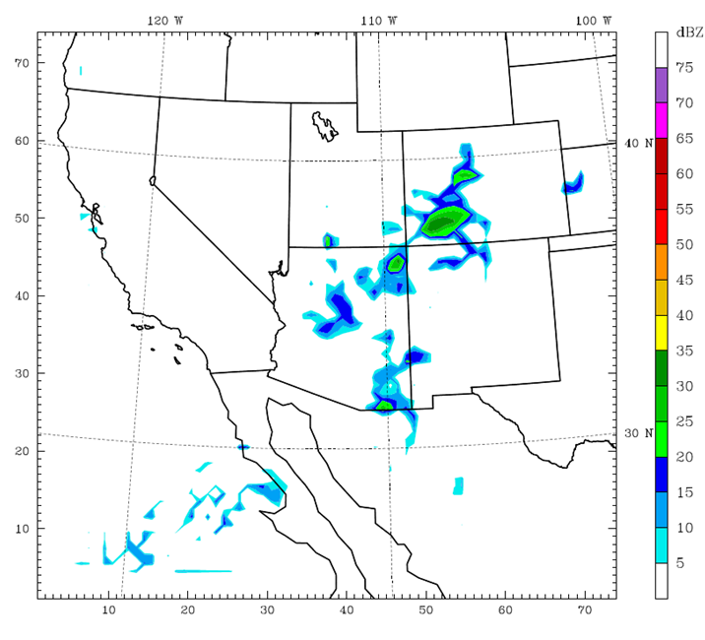
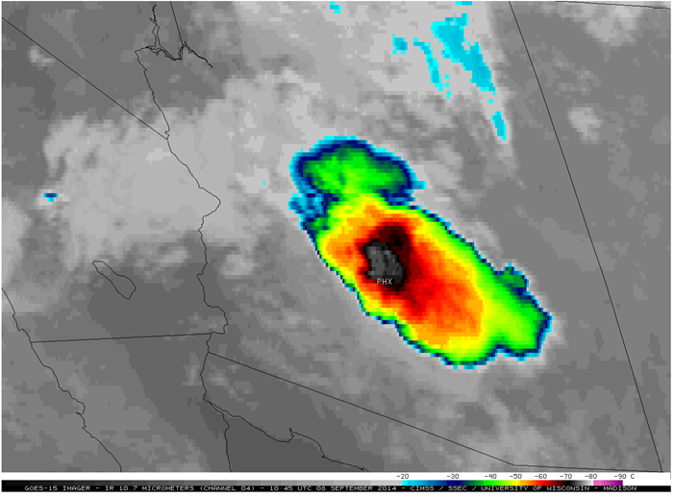
Conclusions and Future Directions
Observations and mesoscale modeling tools improve the understanding of the role of radiative and thermodynamic conditions on surface heating and convective intensity
Model validations with satellite and radar products demonstrate skill of the WRF-ARW in predicting the conditions during the flash flood event
Model resolution is refined, the model remains stable, and most variables agree with observations
Interrelationships between SSTs in the Gulf and rainfall amounts in adjacent land regions need further evaluation

